Slide 1


Salary Prediction for AMCAT Test Takers
Praveen Chand
Ayushi Srivastava
Aparna Dinesh
Gourav Gupta
S.David Aasir Richardson Mentor
Animesh Devarshi

Slide 2

AMCAT?
Increase in number of candidates entering the global workforce every year is an issue as it becomes difficult to filter suitable candidate for a suitable job opening.
AMCAT is an Employee Ability Test that helps to filter out the candidates on the basis of a standardized test.

Slide 3
PROBLEM STATEMENT
We are trying to utilize the dataset containing information about a set of engineering graduates and their employment outcomes provided by AMCAT to analyse the following few use cases –
From the given student profile, can we predict his/her annual salary?
Can we understand what factors in the labour market determine one’s salary?
Is it just one's skills or there are other factors influencing jobs in the current market?
Are there any biases in the labour market which impact one's job?

Slide 4
DATA DESCRIPTION
The dataset consists of 3998 student records with 38 different columns containing student information with the help of which we are trying to find the underlying Salary pattern.
Sections
Personal info | Date of birth and Gender.
Academic info | 10th , 12th , College details and Graduation years.
Cognitive skills | AMCAT standardized test scores (Quant, English, Logical)
Personality traits | Agreeableness, Extraversion, Neuroticism, Openness to Experience, Conscientiousness

Slide 5
DATA PREPARATION FOR ANALYSIS
Subjective imputation for Graduation year, Salary, DOB, DOJ etc
Uniform conversion of College GPA to percentage
Segregation of 10th and 12th board to 4 levels, Specialization to 9 levels and Job City to respective categories
Calculated columns : Age, AgeJ, Experience, Max_score, gapgrad

Slide 6
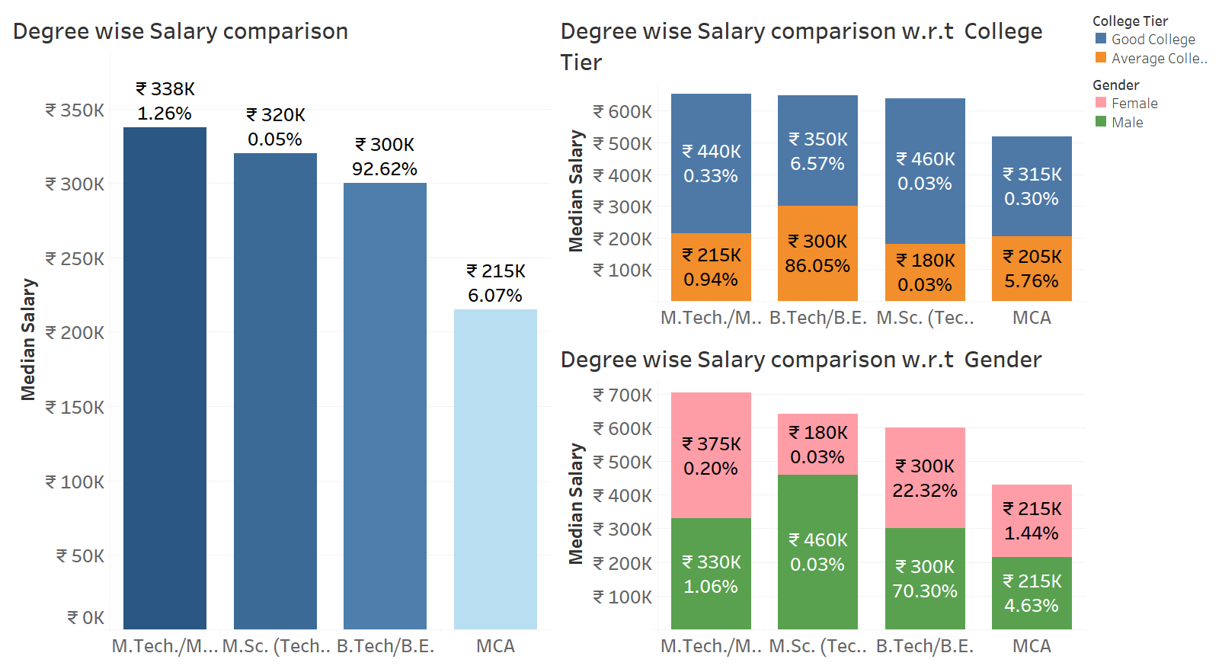
EDA INSIGHTS

Slide 7
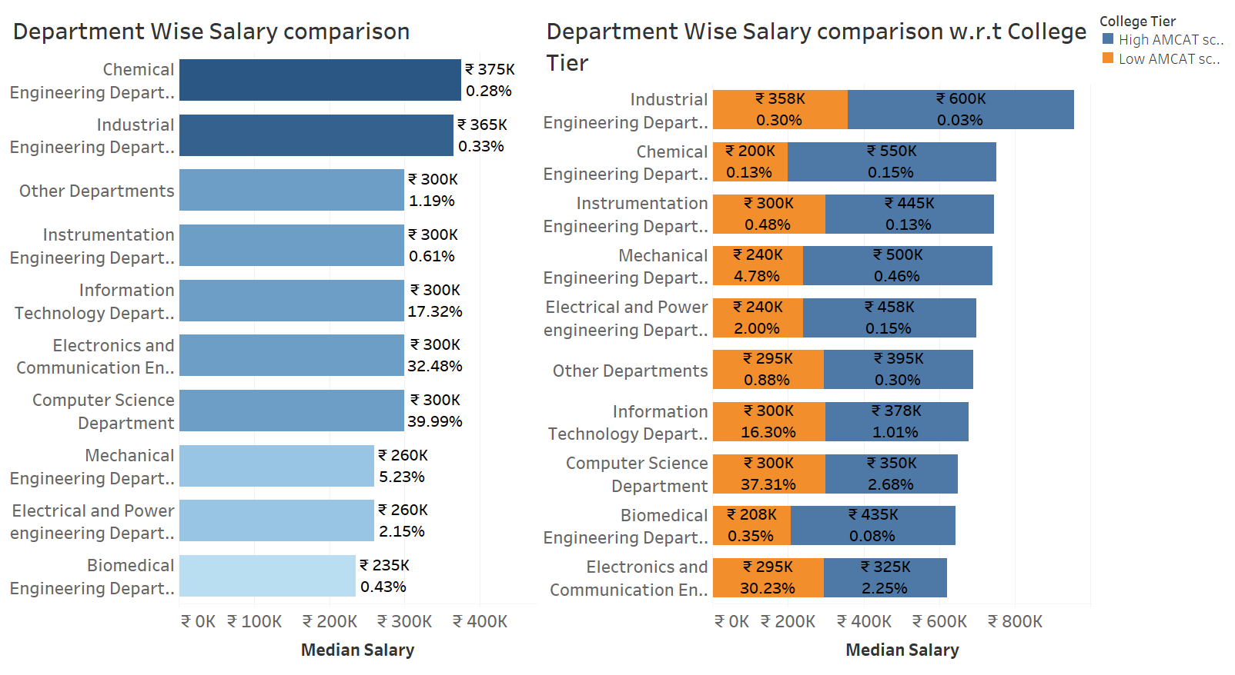

Slide 8
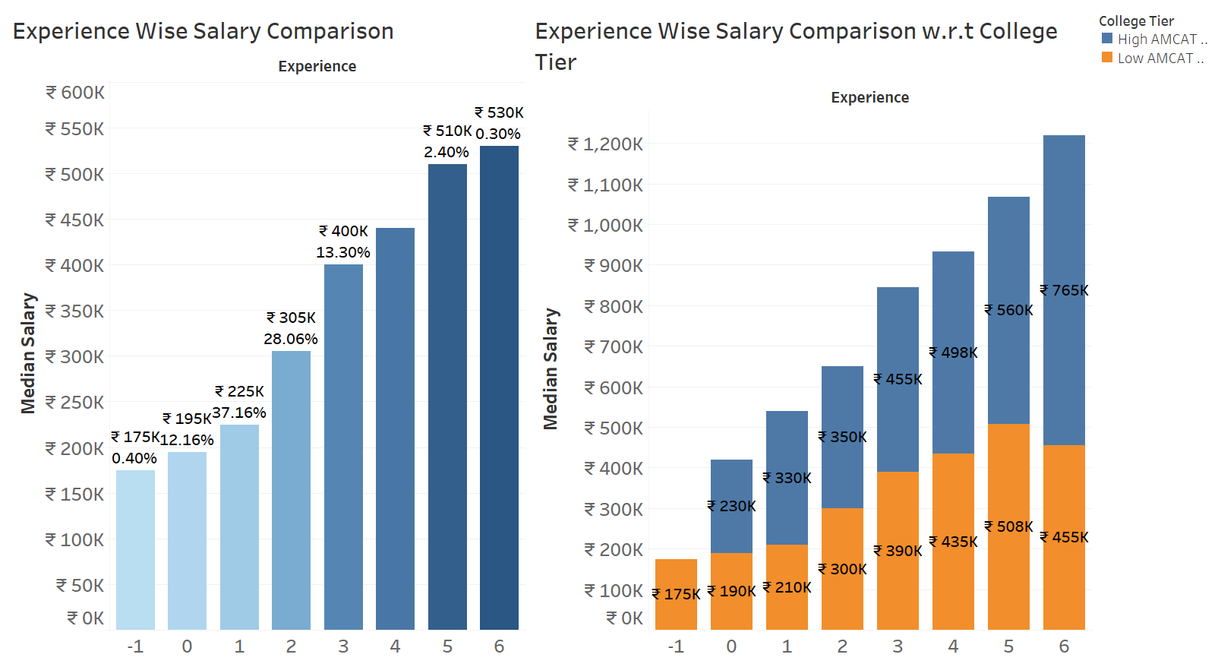

Slide 9
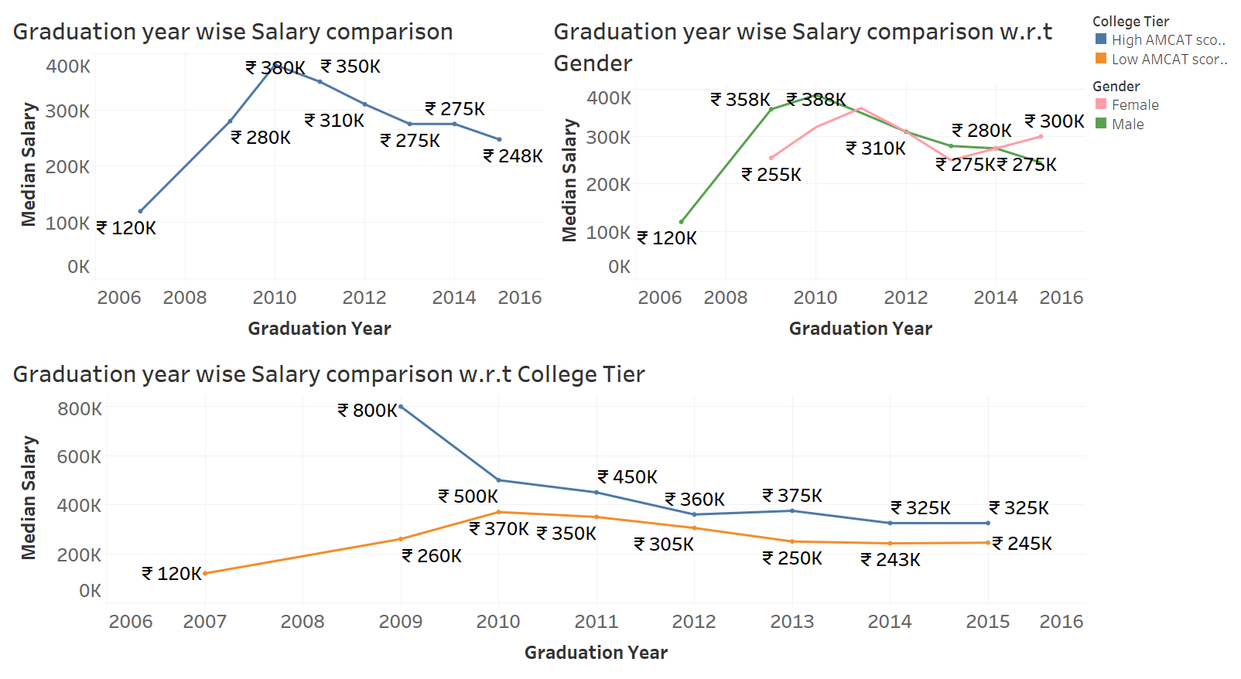

Slide 10
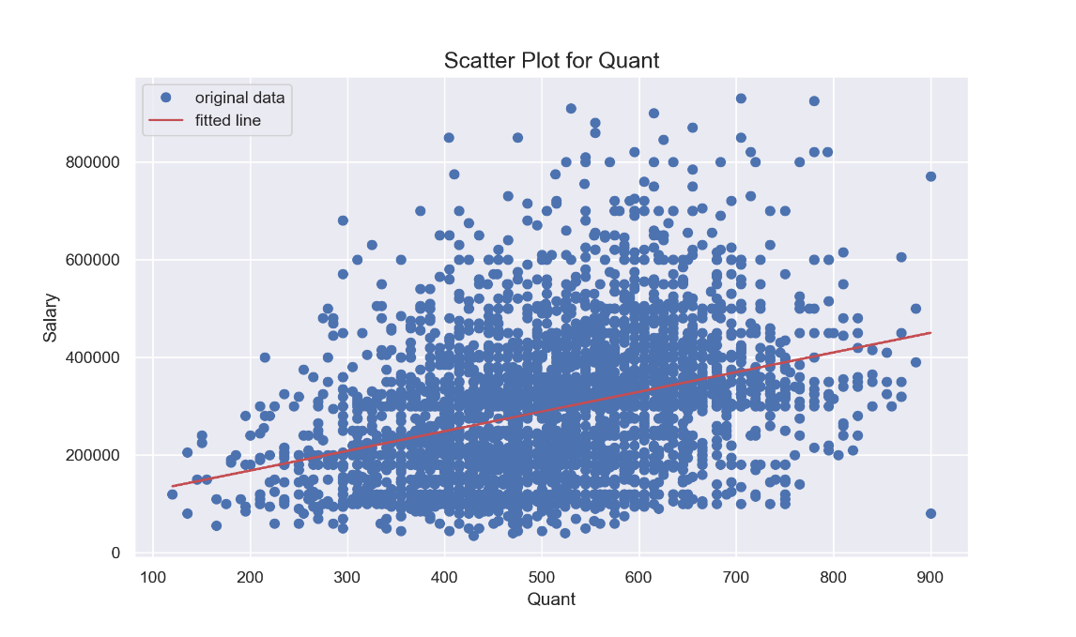
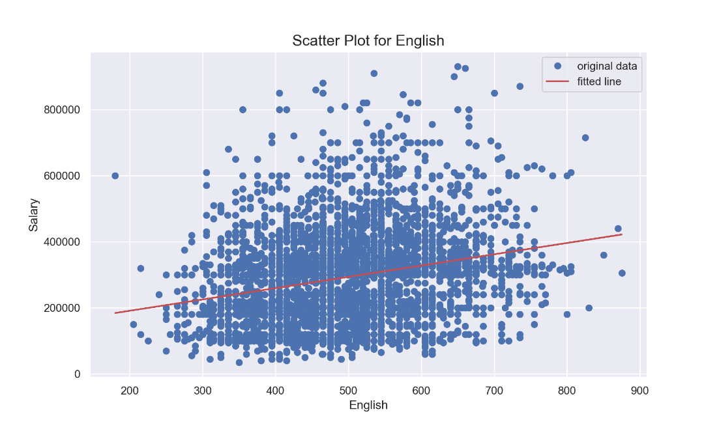

Slide 11
REGRESSION MODEL
Models | R Squared | RMSE
Stats model Linear Regressor | 53.4% | 1,04,228
Sk-learn Linear Regressor | 52.8% | 97,441
Random Forest Regressor | 48.5% | 1,02,281
DecisionTreeRegressor | 40.44% | 1,10,016
Ridge Regression | 53.1% | 97,532
Lasso Regression | 52.8% | 97,846
Elastic Net | 45.5% | 1,05,232
Considering both R^2 score and RMSE (Root mean squared error) the best model the dataset shows is Ridge Regression.
However, the high RMSE scores are pointing towards wrongful prediction of the target variable
Hence we will be dividing Salary into multiple classes and try to build a classification model over it

Slide 12
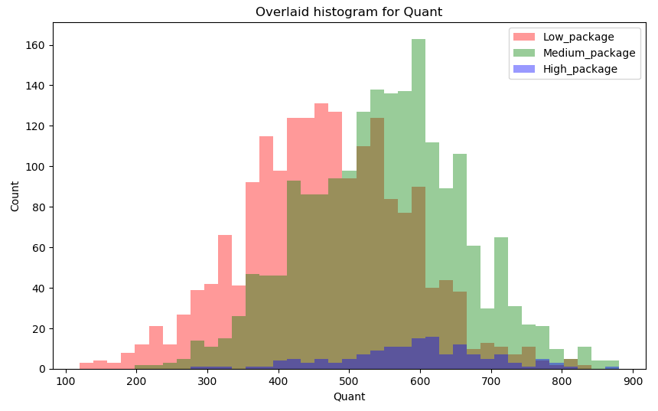
EDA INSIGHTS FOR CLASSIFICATION

Slide 13
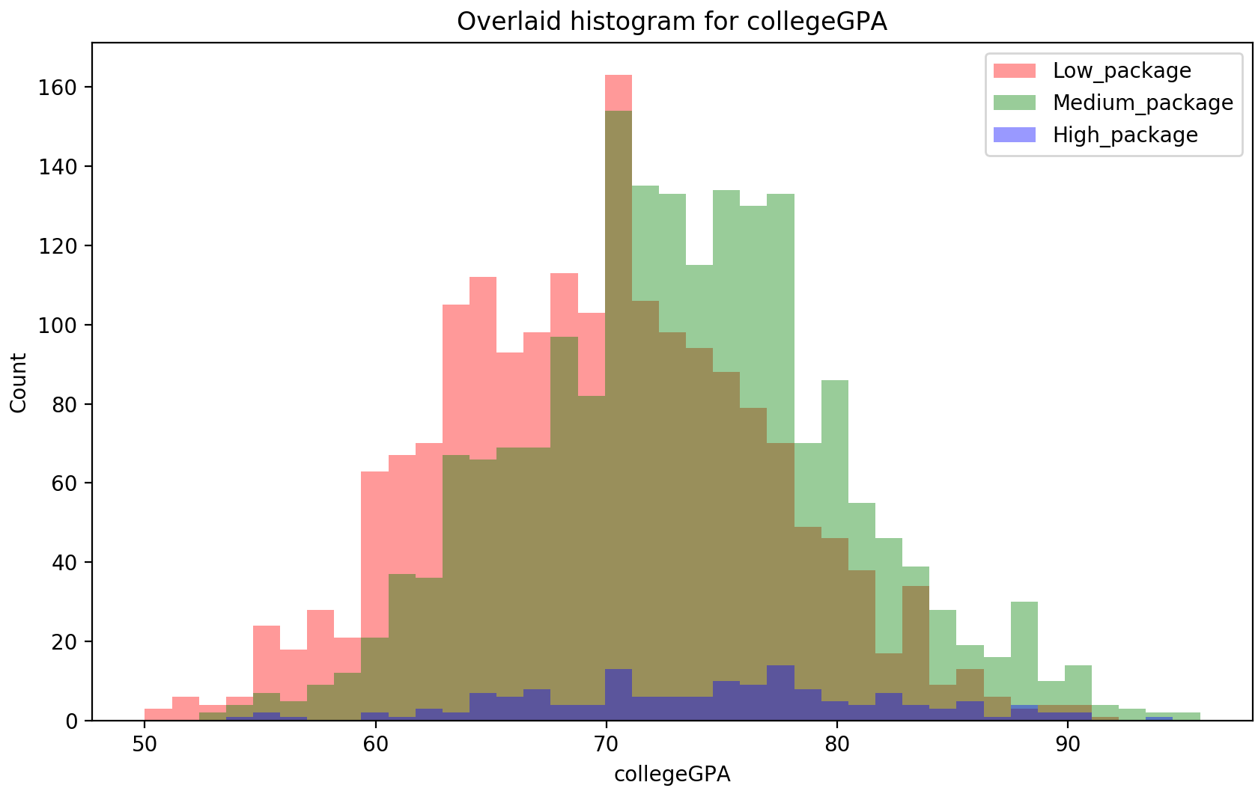

Slide 14
HANDLING IMBALANCED DATA
Target variable salary is classified into three categories: High(>6lakhs),medium(3-6 lakhs) and Low(<3lakhs) packages.
64% Accuracy, 60% precision and 62% recall(Imbalanced data)
SMOTE(Oversampling technique) was used to rectify the imbalance in data.
(No. of records increased from 3956 to 5844).
Relative Frequencies of our classes before and After SMOTE.
Class | Before | After
Low package | 49.2% | 33.33%
Medium package | 46.2% | 33.33%
High package | 3.8% | 33.33%

Slide 15
CLASSIFICATION MODEL
Models | Accuracy | Recall | Precision
Logistic Regression | 65% | 65% | 65%
RandomForestClassifier | 74% | 74% | 76%
GradientBoostingClassifier | 79% | 79% | 80%
XGBoostClassifier | 80% | 81% | 80%
AdaBoostClassifier | 69% | 69% | 70%
XG Boost Classifier is performing better than the other models after appropriate hyper-parameter tuning.
(learning_rate:0.1,max_depth:5,n_estimators:100)
80 % Accuracy, 81 % precision and 80 % recall.

Slide 16
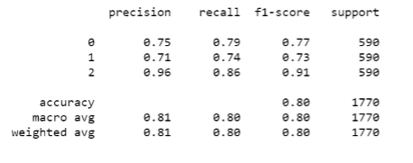
XG BOOST CLASSIFIER
Multiclass performance is evaluated using F1 score
Precision, Recall ,F1 scores and Confusion matrix:
Low package - 0, Medium package -1, High package - 2
Model has higher precision and recall for High package.
Low and Medium package have similar precision and F1 score.

Slide 17
LIMITATIONS IN THE DATASET
The publicly available dataset of AMCAT did not contain a large number of student records so the algorithms might not be appropriately predictive
Dataset was not optimal as some data points have values that logically don’t make sense.
Validation dataset was not available so the models that were built could not be tested on external datasets.
New emerging skills such as AI, IoT, Cloud Computing etc. are not a part of the dataset. Hence, the important skills for predicting salary may differ over time.

Slide 18
CONCLUSIONS
As per the dataset, there is no bias in the current labor market however we have observed that MCA graduates tend to get lesser package as compared to graduates in other streams.
With the given student's profile, we can predict the bracket in which the student salary will lie in.
Along with the salary bracket, we can also give insights about the factors which are creating better impact in the labor market

